Slide 1


Education through collaborating on real world problems
https://omdena.com/chapters/

Slide 2

Solving community problems using Artificial Intelligence
https://omdena.com/omdena-chapter-page-nigeria/

Slide 3

Agenda
Introduce Chapter Lead/Product Owner(s)
Introducing Omdena Lore (Omdena Team will talk for 2-3 mins)
Problem Statement
Project Goals
Learning Outcomes
Task channels
Methodology
Result
Impact
Reference Materials
Member Rules & Guidelines
Member Benefits
Week 1: Understanding the problem

Slide 4

Opeyemi Adeniran has professional certificates in Artificial Intelligence (Microsoft), Data science (IBM), Project Management (British Academy), and Business School (Future Female)
In addition, Opeyemi has 13 course certificates in A.i, machine learning, leadership, sustainability, communication skills, and also as a product owner from Omdena
Opeyemi graduated with a (B.tech) in computer engineering from Ladoke Akintola University of Technology and founded Favored online skills acquisition network in the year 2018
Opeyemi Taiwo Adeniran,
Omdena Lagos, Nigeria Chapter Lead

Slide 5

Introducing Omdena Lore
OmdenaLore: World’s biggest AI4Good library for real-world projects
Speaker: Kaushal Bhavsar
VP of Platform Engineering

Slide 6
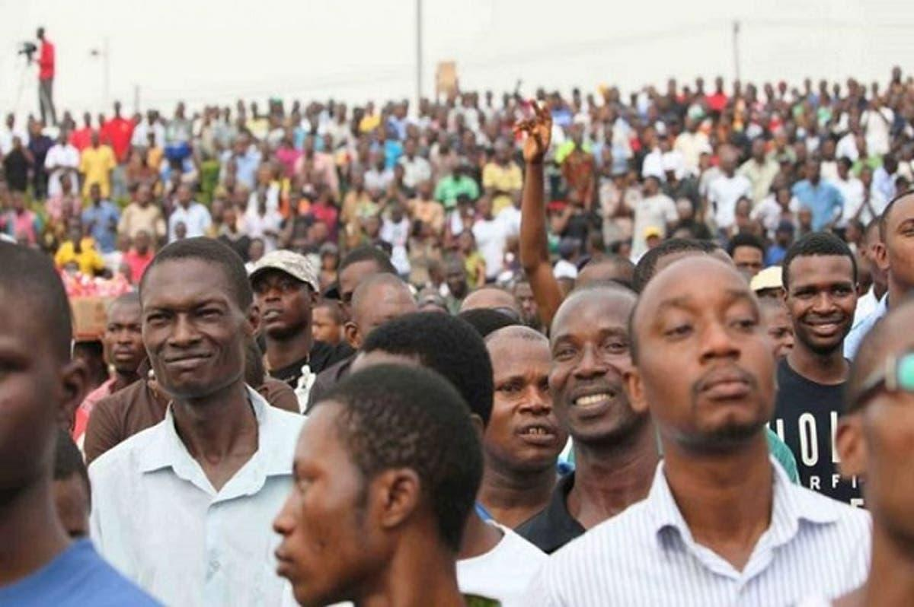
The Project
Solving Unemployment in Nigeria using Artificial Intelligence

Slide 7
Problem Statement
The Unemployment rate in Nigeria increased to 33.30 percent in the fourth quarter of 2020 from 27.10 percent in the second quarter of 2020 while the underemployed rate is 28.7% giving a total percentage rate of 61.9% of Nigerians that are unemployed or underemployed

Slide 8
Project Goals
To create a machine learning model that will merge NYSC graduates with possible job opportunities based on their career path
To provide employable job skills recommendation to NYSC graduates based on their their career path

Slide 9

Learning Outcomes
Data collection
Web scraping
Machine learning model
Natural Language Processing
Recommender system

Slide 10

Task Channels
Task 0: #knowledge
Task 1: #data-gathering
Task 2: #data-visualization
Task 3: #data-Modelling
Task 4: #skills-building
Task 5: recommender-system

Slide 11
Methodology
Candidate Dataset
Demographic (Age, Gender, State, Address)
List of previous courses and education level
Disabilities
Skills
Location
Jobs
Modelling
Merge Candidate + Jobs listing dataset based on Education and skills and location, exclude people below 25 and above 65
Recommender System
Jobs Available dataset
List the most relevant jobs available
Skills

Slide 12

Methodology
A weekly goal is set based on the previous week achievement and the project over-all goals

Slide 13

Result
A recommender system that recommends jobs or skills to candidates based on their profile

Slide 14
Impact
Provide skills recommendation for people looking for job
Provide job opportunities for people without jobs
Reduce the stress of looking for qualified candidates for a particular job role
Help people to acquire the right skills

Slide 15
Reference Materials
https://nilg.ai/blog/202101/reducing-unemployment-using-ai/
https://github.com/dssg/IEFP-RecSys_public
https://www.dssgfellowship.org/project/predicting-long-term-unemployment-in-continental-portugal/
https://knoema.com/atlas/Nigeria/Unemployment-rate
https://www.bloomberg.com/news/articles/2021-03-15/nigeria-unemployment-rate-rises-to-second-highest-on-global-list
https://www.theglobaleconomy.com/Nigeria/unemployment_rate/
https://www.bloomberg.com/news/articles/2021-03-15/nigeria-unemployment-rate-rises-to-second-highest-on-global-list

Slide 16
Member Rules & Guidelines
Main tasks are predefined and everyone will be free to join the task(s) they find best fit for them.
New sub tasks can be created if necessary after consulting the chapter lead(s)/product owner(s).
Task leaders will self-identify or be identified for each task to present the progression in the weekly meeting
English is the language to be used for any communication about the project (Slack,mail,...)

Slide 17

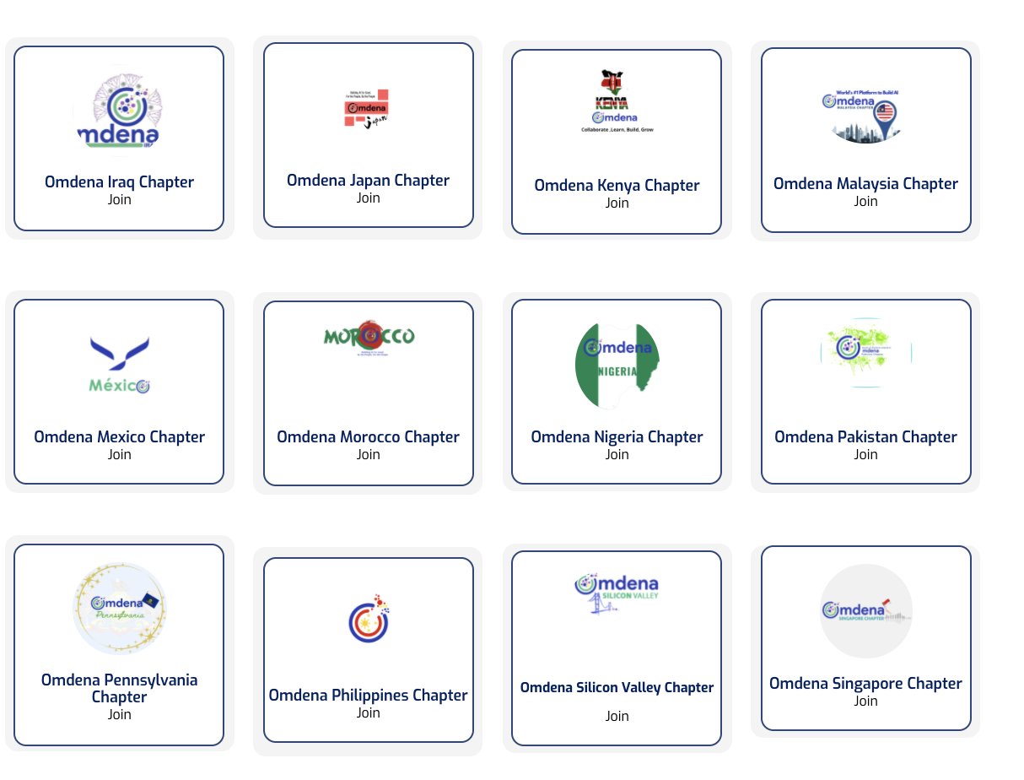
Education through Collaborating on Real World Problems
Omdena Local Chapter Member Benefits
Learn how real-world data science projects are solved by getting hands-on experience
Develop your DS/AI skills and showcase them through open-source solutions
Network with chapter members and leads from 25+ different countries
Preferential selection to the Omdena core challenges and future access to Omdena members benefit platform.
The mission of Omdena Local Chapters is to run open-source AI projects to solve challenges faced by local communities
Chapters in 25+ countries
Starting 10+ projects per month
80+ collaborators per project

Slide 18
Week 1: Understanding the problem
#Task-0
Understand the problem
Announce and assign task leaders
Get resources that can help us throughout the project
Identify platforms, organisations and communities for extracting and collecting data
Identify the tools needed for the project
Identify the technical skills we need to learn
Identify people that can teach us this skills
Checking for available tutorials from Omdena that may be needed for this project
Use the tutorial available to learn how to extract and clean data

Slide 19

keep in touch on slack

